Slide 1


Automated Aneurysm Centerline Extraction Using Deep Learning: A Point Cloud-Based Approach
Master thesis kick-off presentation
Presenter: Aniruddha Deshmukh
Matriculation number: 225855
Supervisor 1: Supervisor 2:
Msc. Iam Spitz Prof. Dr.-Ing. habil. Sylvia Saalfeld
Chair of Visualization Chair of Visualization
OVGU, Magdeburg OVGU, Magdeburg

Slide 2
Agenda:
Introduction
Motivation
Methodology
Initial results
Current progress
Upcoming tasks and deadlines

Slide 3
PIPELINE
04
Optimization of model
05
Comparison with other models
06
Documentation
01
Literature Research
02
Analysing dataset
03
Setting up PointNET
architecture

Slide 4
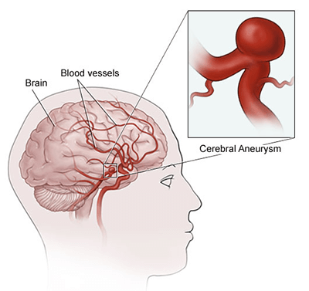
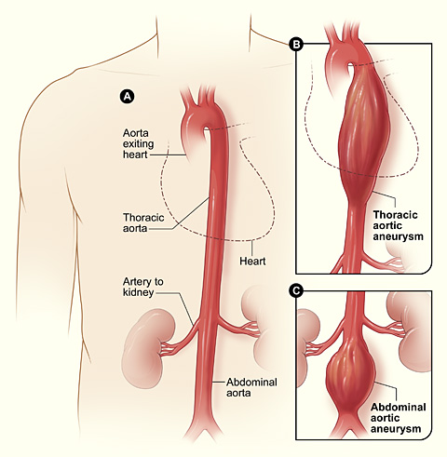
Background and Motivation:
Aneurysms are a significant health concern globally, with millions affected.
Deaths related to aortic aneurysms have been increasing, emphasizing the need for advanced detection methods
Brain aneurysms are abnormal bulges in brain blood vessels, posing severe risks like rupture and thromboembolism.

Slide 5
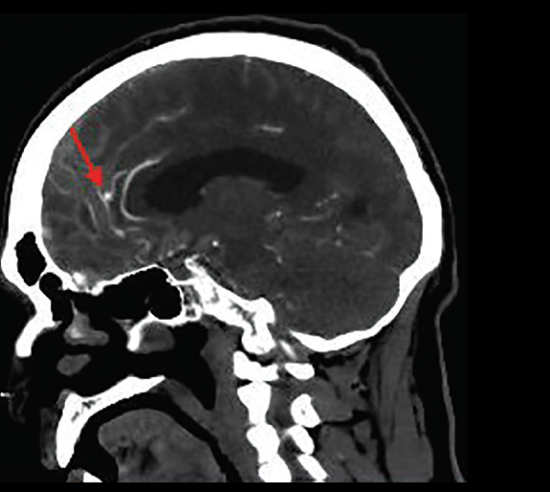
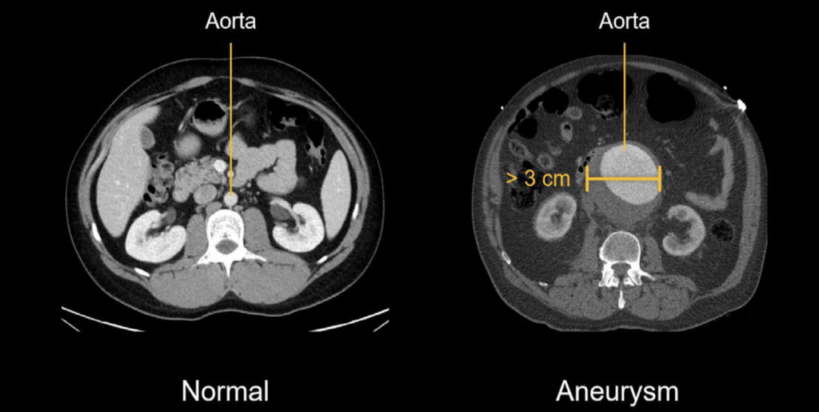
Diagnostic Methods and Treatment Options:
Diagnostic tests like CT scans and MRIs are crucial for detecting aneurysms.
Treatment options range from lifestyle changes to surgical interventions based on factors like age and aneurysm size.
Aneurysm detection relies on visual assessment of scans , prone to human error and inconsistency, impacting diagnosis outcomes.

Slide 6
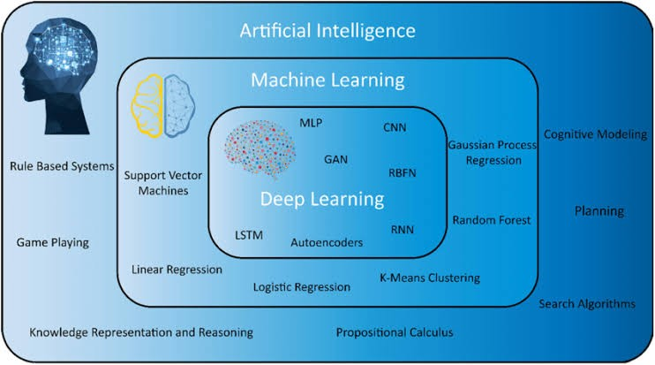
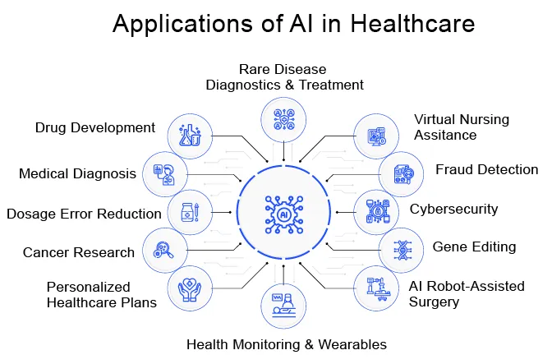
Introducing Artificial Intelligence:
For medical imaging, deep learning is preferred over machine learning because of feature learning, complex data handling, performance, scalability and continual improvement.

Slide 7

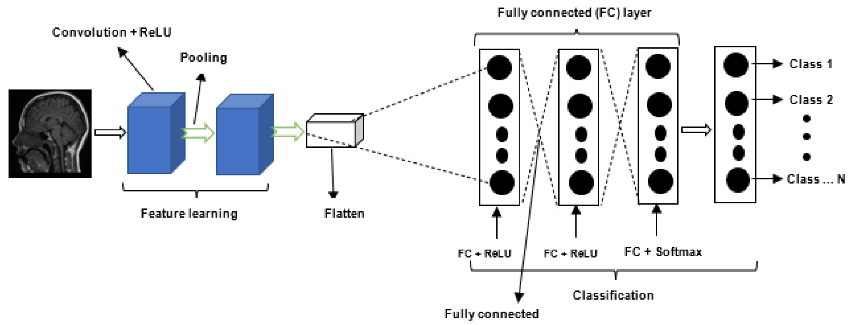
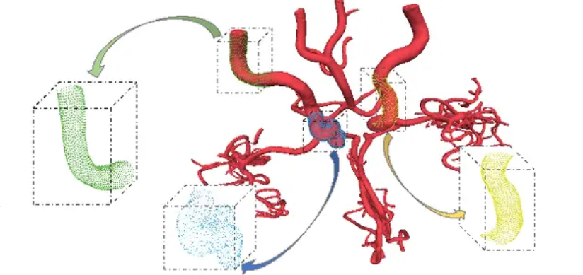
The intelligence of AI in medical imaging has lead to significant advances in computer aided diagnosis.
Most of the deep learning studies focuses on 3D images such as CNN, RNN rather than geometric point cloud
Since complex structure arteries and veins are present brain, legs are aorta , we therefore need to change our focus from tradition 3D images to geometric point cloud.
In this thesis, I will be focusing on deep learning model based on point cloud known as PointNET for aneurysm detection.

Slide 8
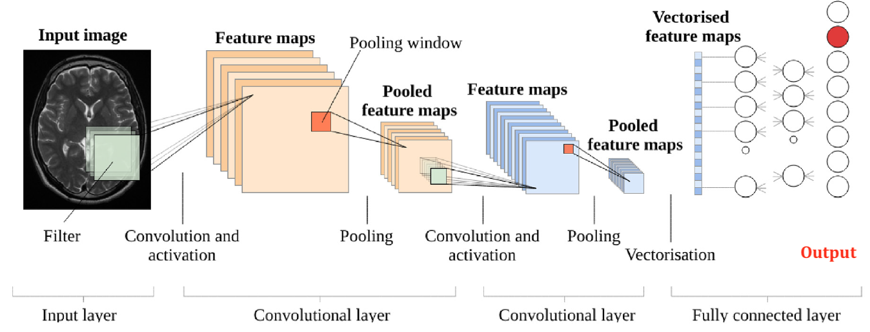
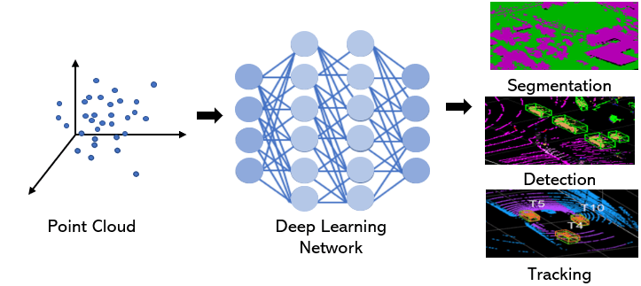
Approach | Advantage | Disadvantage
CNN | Comprehensive and detailed view of brain structures Extract important features and characteristics of aneurysm | Computationally intensive Require large data and resources
PointNet | Focused and targeted view of arteries and aneurysms Less computationally intensive More robust to noise and artifacts | May not provide comprehensive view of brain Require mesh artery extraction from MRA images

Slide 9
Research Question
Can a deep learning model based on PointNET accurately predict the centerline of a 3D aneurysm surface mesh, and how does it perform compare to traditional methods?

Slide 10
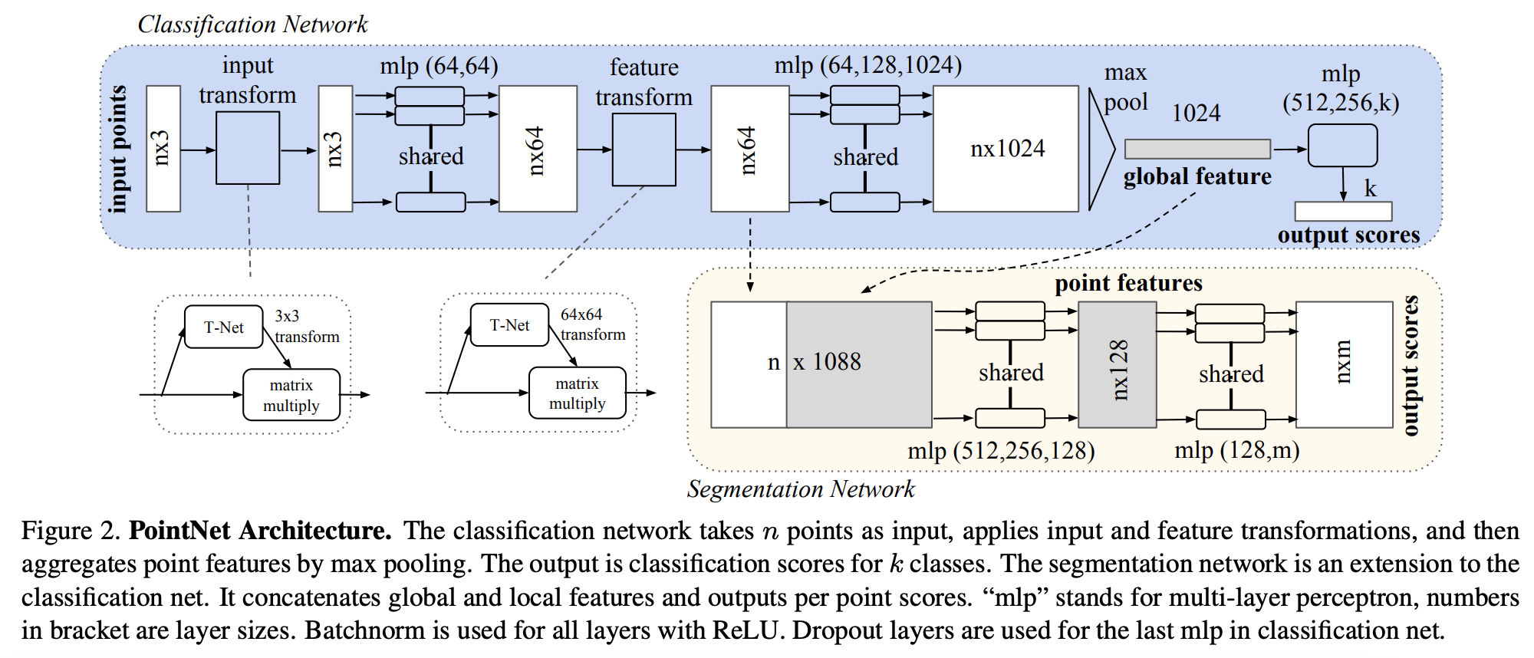
PointNET Architecture
PointNet offers a novel approach to processing 3D point cloud data.
Its architecture is specifically designed for classification and segmentation of point clouds.

Slide 11
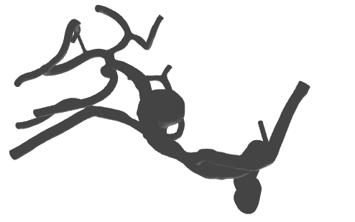
Methodology
Steps | Description
Preprocessing | 1.1 Convert the 3D Mesh into a point cloud 1.2 Create new points inside the mesh 1.3 Load the centerline points (i.e. the centerline) 1.4 Find the closest blue point for each centerline point and classify it as centerline (green points)(KD Tree)
Training | 1.5 Assign ID 1 to all blue points and ID 2 to all green points 1.6 Splitting of datasets 1.7 Train the network using the labeled point cloud data
Post-processing | 1.8 If model overfits, data augmentation 1.9 Fine tuning the parameters 1.10 Evaluating model performance

Slide 12
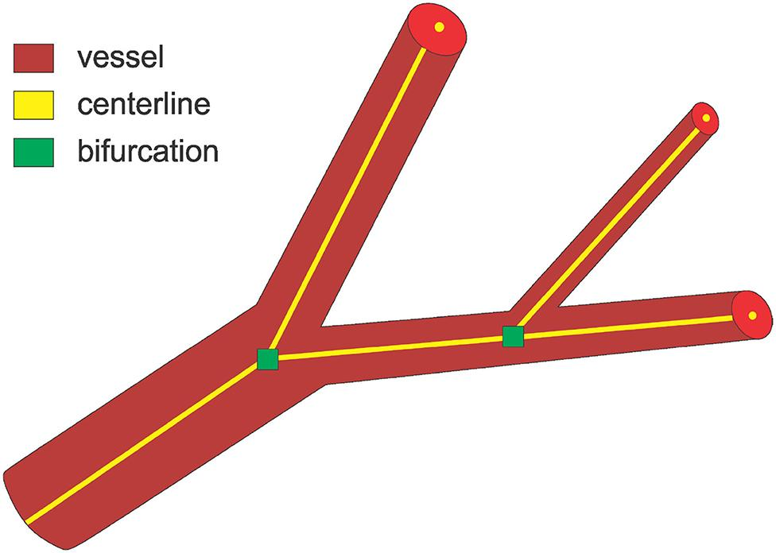
Methodology:
A centerline is a skeleton or medial axis of a tubular structure, such as blood vessels, airways, or other anatomical structures.
Accurate centerline detection is crucial for understanding vessel morphology.
Centerline extraction can be used to aid in the diagnosis and treatment of
various medical conditions, including aneurysm detection, stent planning,
and endovascular repair.
PointNet can be used to distinguish between centerline points and
non-centerline points in the point cloud.

Slide 13
Pipeline of my thesis:
Preprocessing of data
Splitting dataset into testing , validation and training set
Train network
Test network
START
Evaluate model parameters
Best fit
Parameter tuning
If model overfits or underfits
FINISH

Slide 14
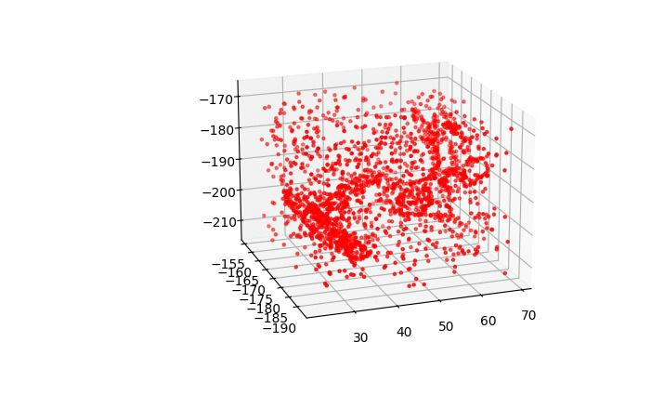
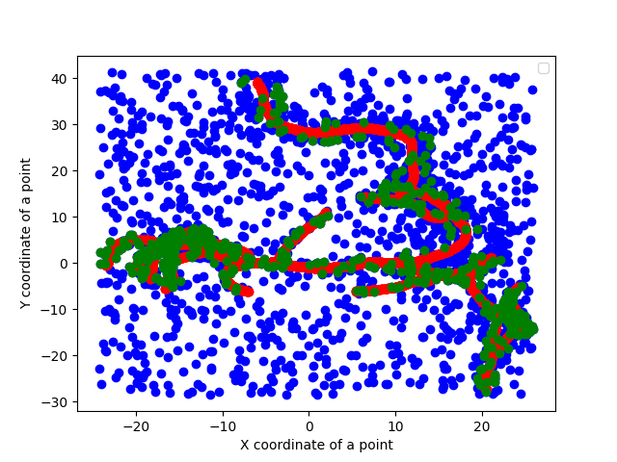
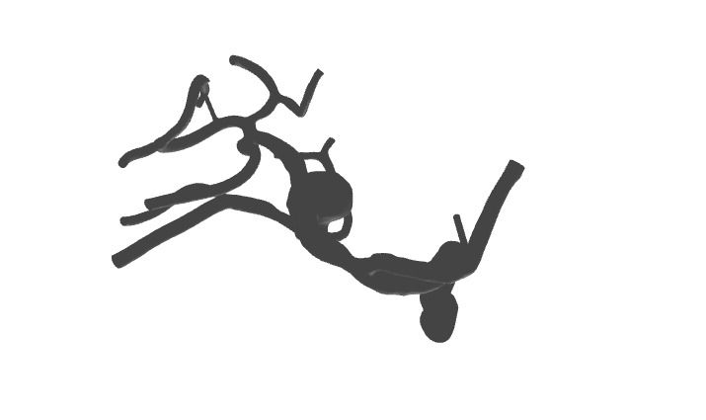
Current Progress and Results:
Already started implementing PointNet model using the datasets provided.
Convert to point cloud
PointNET

Slide 15
Results:
Red points - centerline points
Green points - points near to centerline points
Blue points - points far away from centerline points
Accuracy: Measures overall correctness of predictions.
Accuracy: 0.841
Precision: Focuses on the accuracy of positive predictions.
Precision: 0.707
F1 Score: Harmonic mean of precision and recall, balancing both metrics.
F1 Score: 0.768
Loss:
Epoch 1= 0.509, Epoch 5= 0.471
Epoch 10 = 0.502 , Epoch 15 = 0.378 , Epoch 20 = 0.501

Slide 16
Optimization:
Apply data augmentation techniques to create a more diverse dataset.
Train the network with a larger dataset to improve the model's performance.
Evaluate the model's performance by comparing the training and validation dataset.
Analyze the learning curve and observe the model's complexity to determine if the model is underfitting or overfitting.
Introduce a validation set to measure the model's performance during the training process and assess how well the model generalizes to new, unseen data.
Compare the training and validation performance to gain insights into the model's ability to generalize to new data and determine if the model is underfitting, well-fit, or overfitting.

Slide 17
Work done until now:
Steps | Status | Comment
Preprocessing | Done
Splitting into training and testing data and running the whole network | Done
Evaluation of model parameter and hyperparameter tuning | Done
Data Augmentation | In Progress | Since we are working on just 50 datasets , it is necessary to provide more dataset using this technique
Add validation dataset | Not started | This process is done after data augmentation as I will have bigger dataset
Run the network once again | Not started | As soon as you are done with both the above steps you can run the network once again and evaluate the model parameters and tune the hyperparameters accordingly

Slide 18
Tasks | Current status | Expected date of finish | Comments
Literature Review | Done | - | -
Thesis proposal | In Progress | 01.04.2024 | submitted,review in process
Implementing PointNET | In Progress | 15.04.2024 | Finished the pipeline, tested my network by training and testing, To do steps : Data augmentation and adding validation dataset
Optimization of model | Not yet started | 01.05.2024 | Will start next week
Registration of Thesis | In Progress | 15.04.2024 | Not yet decided
Thesis writing | In Progress | 01.07.2024 | Started writing literature review, introduction and methodology
Thesis submission | - | 01.07.2024 | -

Slide 19


